Slide 1
BACKEND PROJECT

Slide 2

WHEN TO START A WORK?

Slide 3
What can we do with this?
There are many programs for time management which can help us.
We choose TODO List because it has an extra simple user interface and free open source license
ToDoLIST

Slide 4
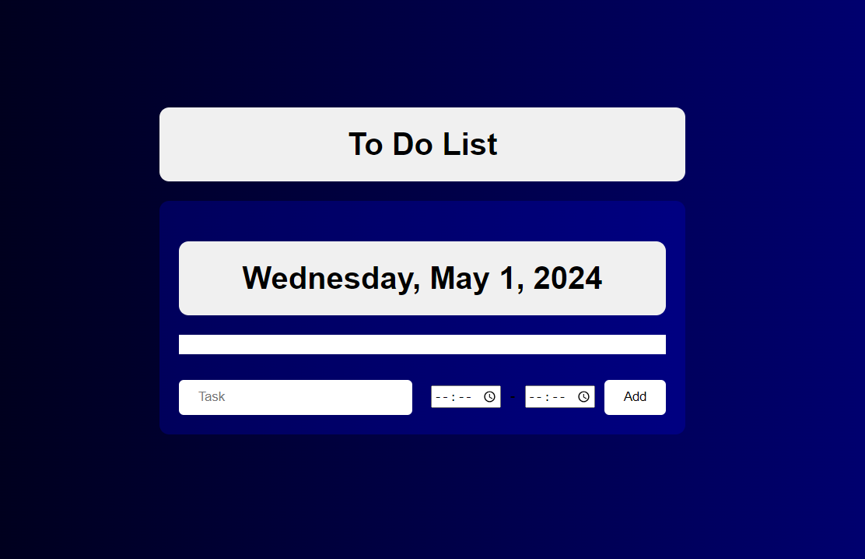

Slide 5
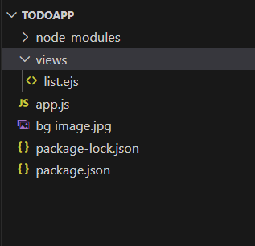
Layout

Slide 6
How It Works?
User Interaction: Users interact with the web page by entering tasks and specifying their start and end times.
Frontend: The HTML, CSS, and JavaScript code create the visual interface and handle user interactions. HTML defines the structure of the page, CSS styles it, and JavaScript adds interactivity.
Backend (Express.js): Express.js sets up the server to handle HTTP requests and responses. It defines routes to manage GET and POST requests for displaying the To-Do list and adding new tasks.
Data Management: To-Do list items are stored as an array on the server-side. When a user adds a new task, it's sent to the server via a POST request, processed, and added to the array.
Rendering: The server renders the updated To-Do list page using EJS templates, passing data such as the current date and list of tasks. EJS templates dynamically generate HTML content based on the provided data.
Client-side Updates: The updated To-Do list page is sent back to the client and displayed in the browser. Client-side JavaScript dynamically updates the UI to reflect changes like adding new tasks or marking tasks as completed.

Slide 7
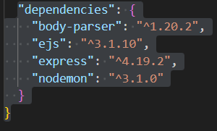
DEPENDENCIES

Slide 8
body-parser: This middleware is used to parse the body of incoming HTTP requests. It extracts data from the request body and makes it available in req.body. This is particularly useful for handling form data or JSON payloads sent in POST requests.
ejs (Embedded JavaScript): EJS is a templating engine for rendering dynamic content in HTML files. It allows you to embed JavaScript code within HTML templates, making it easier to generate dynamic HTML content on the server-side. In your project, you're using EJS to render HTML templates and pass dynamic data to them.
express: Express.js is a minimal and flexible Node.js web application framework. It provides a robust set of features for building web applications and APIs, such as routing, middleware support, and handling HTTP requests and responses. In your application, Express is used to define routes, handle HTTP requests, and render views using EJS templates.
nodemon (Development Dependency): Nodemon is a utility that monitors changes in your Node.js application files and automatically restarts the server when changes are detected. It's particularly useful during development, as it eliminates the need to manually restart the server every time you make changes to your code. While not necessary for production, it greatly improves the development workflow by saving time and effort.

Slide 9
Features And Functionality
Adding Tasks: Users can add new tasks to the To-Do list by entering task details such as the task name, start time, and end time. These tasks are then displayed on the To-Do list.
Displaying Tasks: The To-Do list displays all added tasks along with their start and end times. Tasks are displayed in a clear and organized manner, making it easy for users to see their upcoming tasks.
Checking off Tasks: Users can mark tasks as completed by checking a checkbox next to each task. Completed tasks are visually distinguished from active tasks, providing clarity on task status.
Dynamic Updates: The To-Do list updates dynamically without the need for page refreshes. When a user adds a new task or marks a task as completed, the list updates instantly to reflect the changes.
Persistence: To-Do list items are stored locally in the browser's local storage, ensuring that tasks are retained even after the page is refreshed or the browser is closed. This feature provides persistence between sessions, allowing users to access their To-Do list from any device or browser.
Responsive Design: The To-Do list application is designed to be responsive, ensuring optimal viewing and interaction across various devices and screen sizes. Users can access and manage their tasks seamlessly whether they're using a desktop, laptop, tablet, or smartphone.
User-Friendly Interface: The interface is designed to be intuitive and user-friendly, making it easy for users to add, view, and manage their tasks. Clear labeling and visual cues help users understand how to interact with the application effectively.

Slide 10
CONCLUSION
In conclusion, the To-Do list project is a user-friendly and efficient task management application built using Node.js, Express.js, EJS, HTML, CSS, and JavaScript. It offers a straightforward interface for users to add, view, and manage their tasks effectively. With features such as task persistence, dynamic updates, and responsive design, the application enhances productivity and organization for users across various devices and screen sizes. By providing a seamless and intuitive user experience, the To-Do list project demonstrates the power of web development technologies in creating practical solutions for everyday tasks.

Slide 11
Thank you

